Slide 1
Chapter 2: Operating-System Structures

Slide 2
Objectives
View OS from:
Services
Interfaces
Components and Interconnections
To describe the services an operating system provides to users, processes, and other systems
To discuss the various ways of structuring an operating system
To explain how operating systems are installed and customized and how they boot

Slide 3
Chapter 2: Operating-System Structures
Operating System Services
User Operating System Interface
System Calls
Types of System Calls
System Programs
Operating System Design and Implementation
Operating System Structure
Virtual Machines
Operating System Generation
System Boot

Slide 4
2.1 Operating System Services
Operating systems provide an environment for execution of programs and services to programs and users
One set of operating-system services provides functions that are helpful to the user:
User interface - Almost all operating systems have a user interface (UI).
Varies between Command-Line (CLI), Graphics User Interface (GUI), Batch
Program execution - The system must be able to load a program into memory and to run that program, end execution, either normally or abnormally (indicating error)
I/O operations - A running program may require I/O, which may involve a file or an I/O device

Slide 5
Operating System Services (Cont.)
One set of operating-system services provides functions that are helpful to the user (Cont.):
File-system manipulation - The file system is of particular interest. Programs need to read and write files and directories, create and delete them, search them, list file Information, permission management.
Communications – Processes may exchange information, on the same computer or between computers over a network
Communications may be via shared memory or through message passing (packets moved by the OS)
Error detection – OS needs to be constantly aware of possible errors
May occur in the CPU and memory hardware, in I/O devices, in user program
For each type of error, OS should take the appropriate action to ensure correct and consistent computing
Debugging facilities can greatly enhance the user’s and programmer’s abilities to efficiently use the system

Slide 6
Operating System Services (Cont.)
Another set of OS functions exists for ensuring the efficient operation of the system itself via resource sharing
Resource allocation - When multiple users or multiple jobs running concurrently, resources must be allocated to each of them
Many types of resources - CPU cycles, main memory, file storage, I/O devices.
Accounting - To keep track of which users use how much and what kinds of computer resources
Protection and security - The owners of information stored in a multiuser or networked computer system may want to control use of that information, concurrent processes should not interfere with each other
Protection involves ensuring that all access to system resources is controlled
Security of the system from outsiders requires user authentication, extends to defending external I/O devices from invalid access attempts

Slide 7
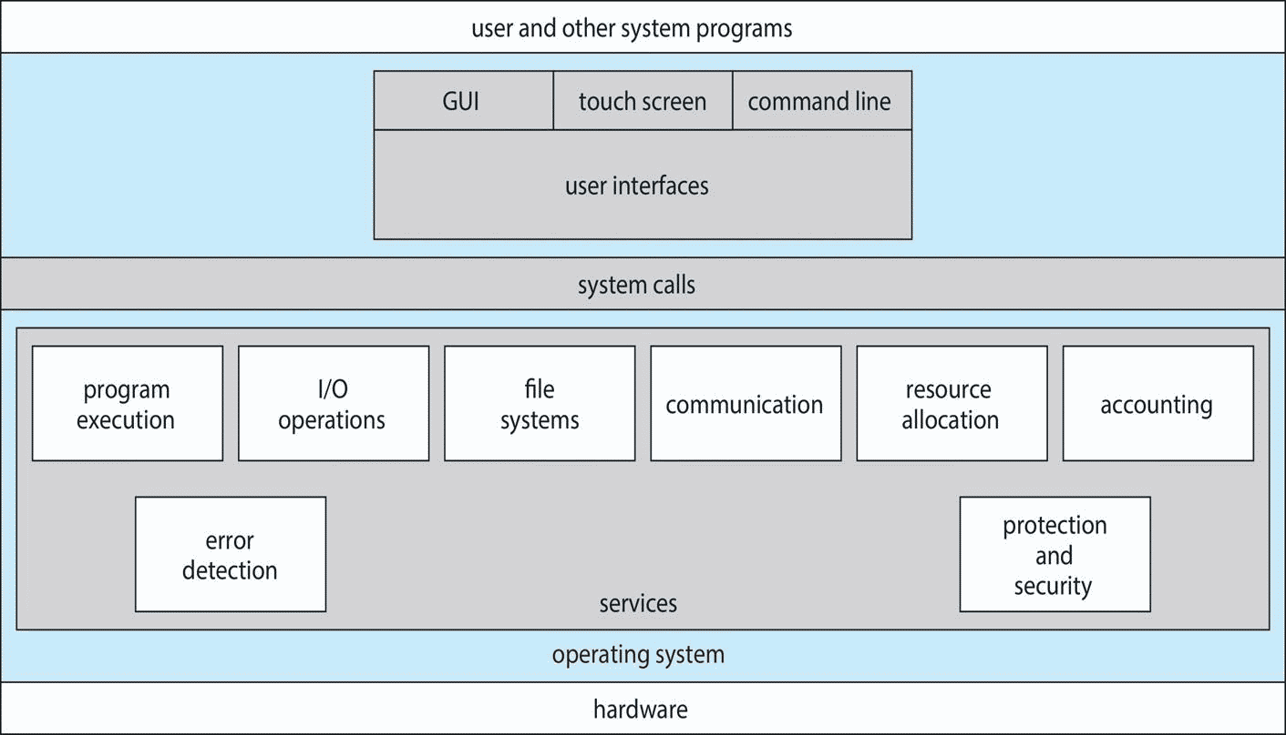
A View of Operating System Services

Slide 8
User Operating System Interface - CLI
CLI or command interpreter allows direct command entry
Sometimes implemented in kernel, sometimes by systems program
Sometimes multiple flavors implemented – shells
Primarily fetches a command from user and executes it
Sometimes commands built-in, sometimes just names of programs
If the latter, adding new features doesn’t require shell modification

Slide 9
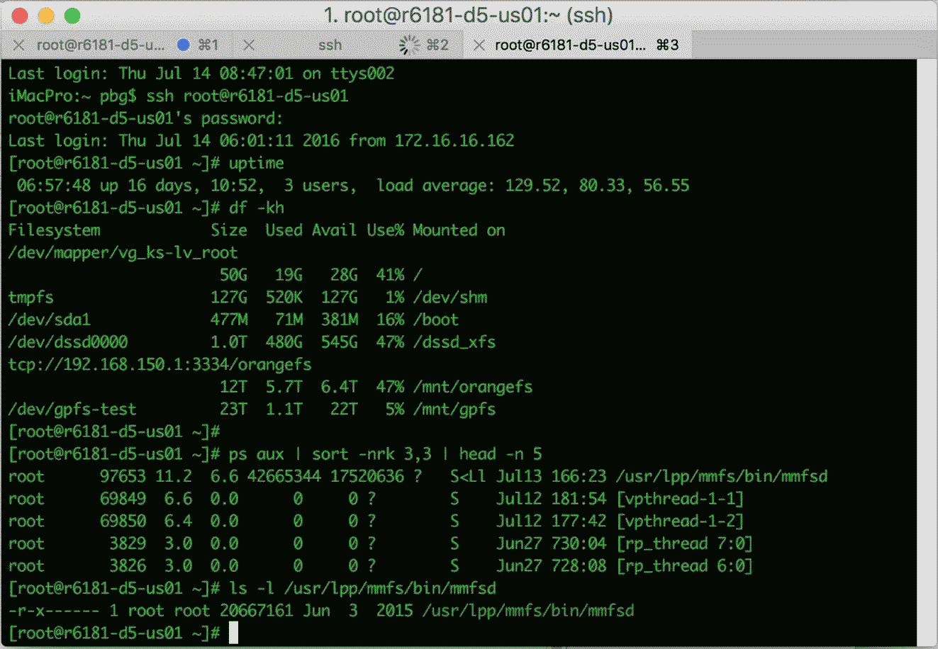
Bourne Shell Command Interpreter

Slide 10
User Operating System Interface - GUI
User-friendly desktop metaphor interface
Usually mouse, keyboard, and monitor
Icons represent files, programs, actions, etc
Various mouse buttons over objects in the interface cause various actions (provide information, options, execute function, open directory (known as a folder)
Invented at Xerox PARC 1970’s
Many systems now include both CLI and GUI interfaces
Microsoft Windows is GUI with CLI “command” shell
Apple Mac OS X is “Aqua” GUI interface with UNIX kernel underneath and shells available
Unix and Linux have CLI with optional GUI interfaces (CDE, KDE, GNOME)

Slide 11
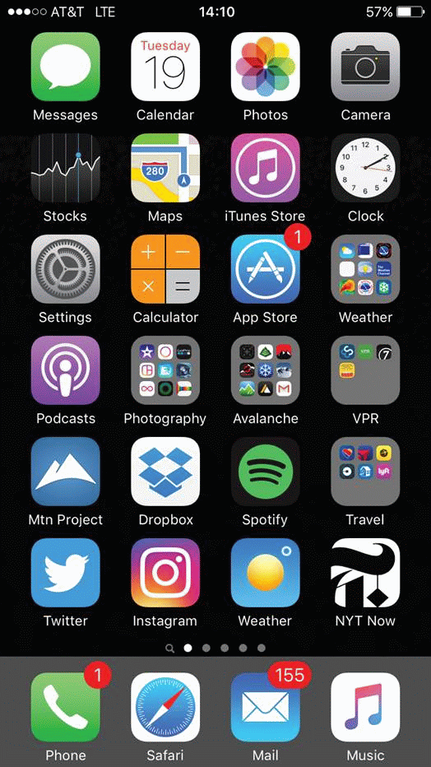
Touchscreen Interfaces
Touchscreen devices require new interfaces
Mouse not possible or not desired
Actions and selection based on gestures
Virtual keyboard for text entry
Voice commands.

Slide 12
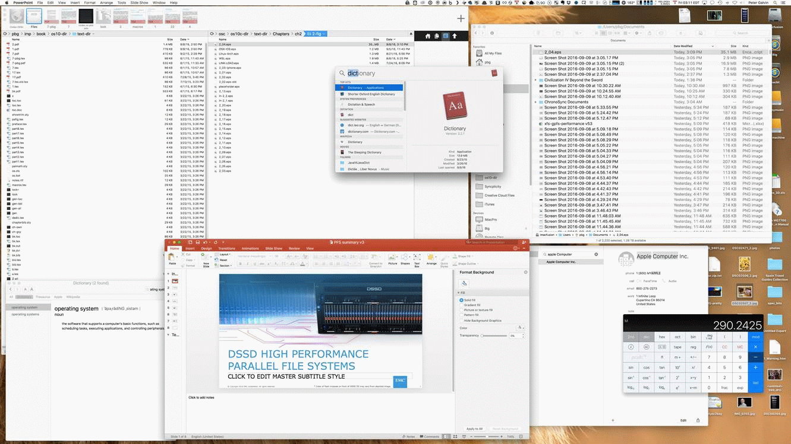
The Mac OS X GUI

Slide 13
2.3 System Calls
Programming interface to the services provided by the OS
Typically written in a high-level language (C or C++)
Mostly accessed by programs via a high-level Application Programming Interface (API) rather than direct system call use
Three most common APIs are：
Win32 API for Windows,
POSIX API for POSIX-based systems (including virtually all versions of UNIX, Linux, and Mac OS X), and
Java API for the Java virtual machine (JVM)
Note that the system-call names used throughout this text are generic

Slide 14
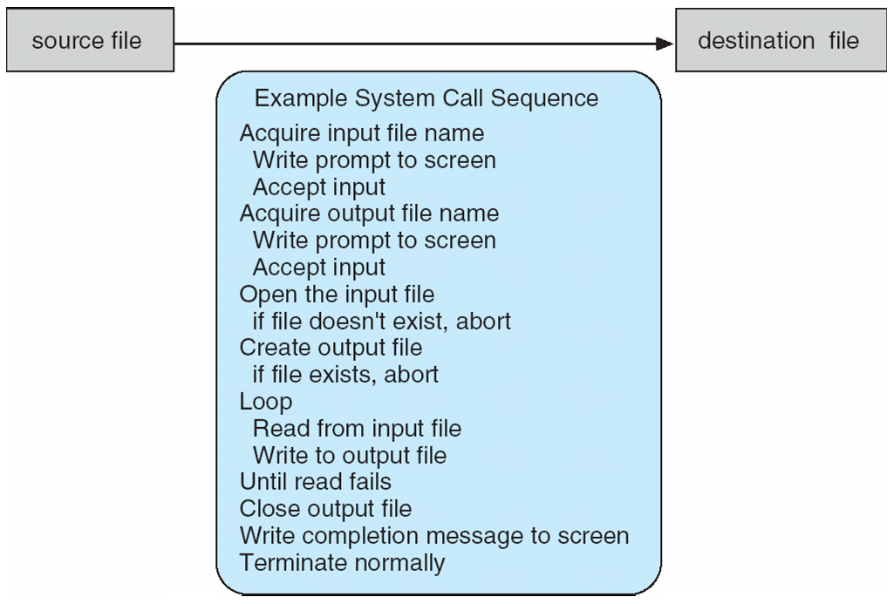
Example of System Calls
System call sequence to copy the contents of one file to another file
Why use APIs rather than system calls? Program portability/convenience/

Slide 15
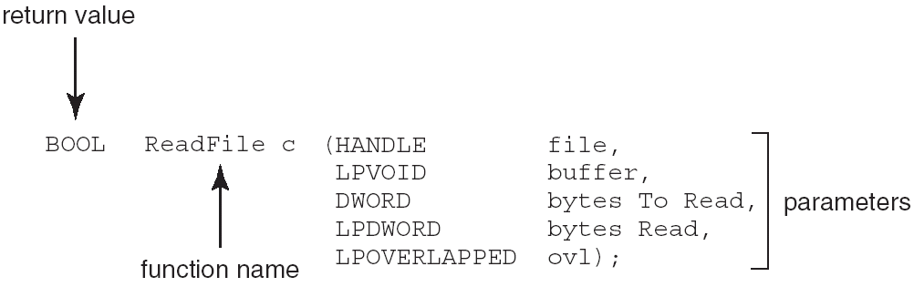
Example of Standard API
Consider the ReadFile() function in the Win32 API—a function for reading from a file
A description of the parameters passed to ReadFile()
HANDLE file —the file to be read
LPVOID buffer —a buffer where the data will be read into and written from
DWORD bytesToRead —the number of bytes to be read into the buffer
LPDWORD bytesRead —the number of bytes read during the last read
LPOVERLAPPED ovl —indicates if overlapped I/O is being used

Slide 16
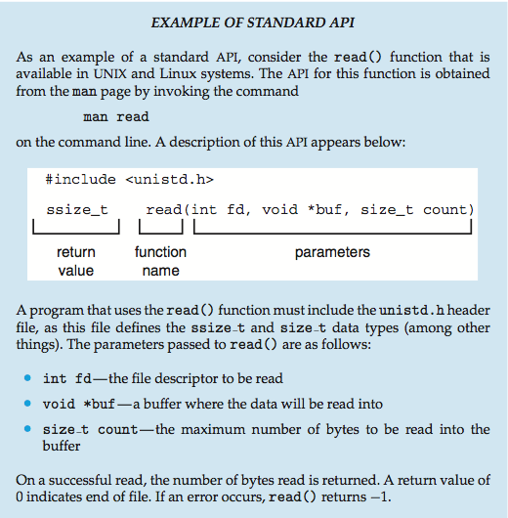
Example of Standard API

Slide 17
System Call Implementation
Typically, a number associated with each system call
System-call interface maintains a table indexed according to these numbers
The system call interface invokes the intended system call in OS kernel and returns status of the system call and any return values
The caller need know nothing about how the system call is implemented
Just needs to obey API and understand what OS will do as a result call
Most details of OS interface hidden from programmer by API
Managed by run-time support library (set of functions built into libraries included with compiler)

Slide 18
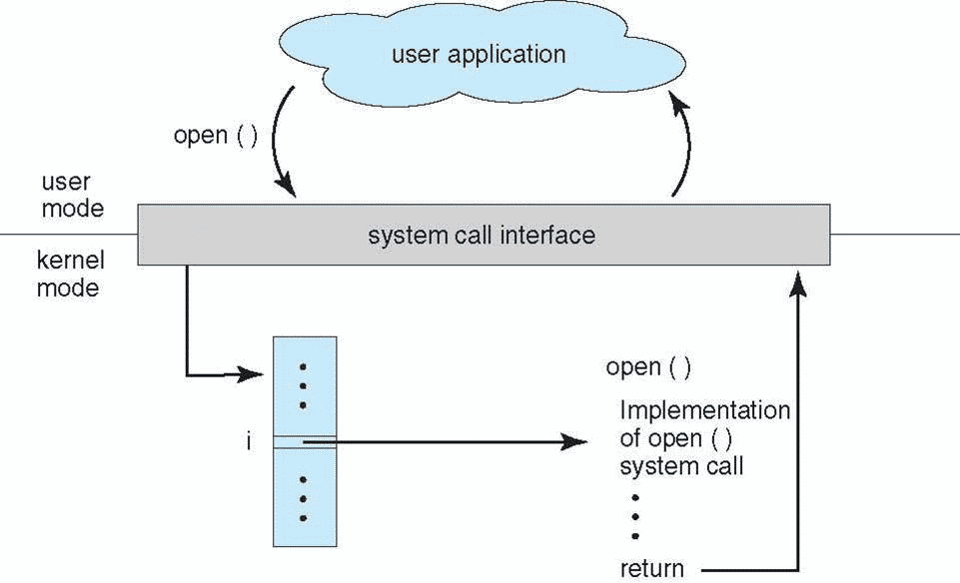
API – System Call – OS Relationship

Slide 19
System Call Parameter Passing
Often, more information is required than simply identity of desired system call
Exact type and amount of information vary according to OS and call
Three general methods used to pass parameters to the OS
Simplest: pass the parameters in registers
In some cases, may be more parameters than registers
Parameters stored in a block, or table, in memory, and address of block passed as a parameter in a register
This approach taken by Linux and Solaris
Parameters placed, or pushed, onto the stack by the program and popped off the stack by the operating system
Block and stack methods do not limit the number or length of parameters being passed

Slide 20
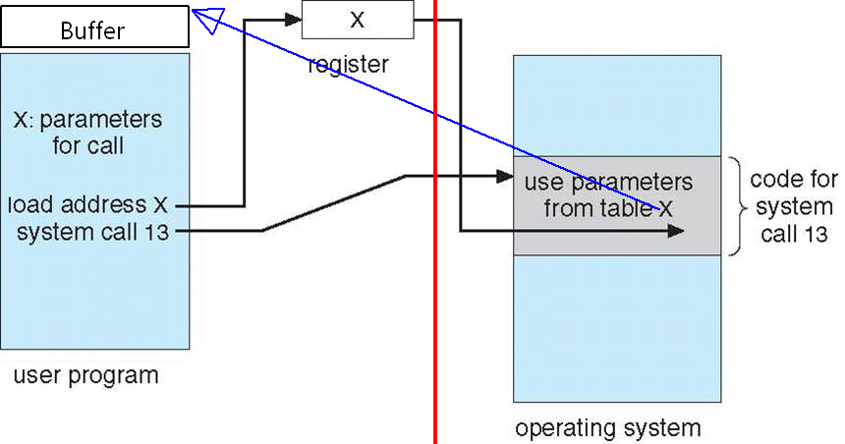
Parameter Passing via Table
X: address of table

Slide 21
Parameter Passing via Table 2
我们假设在某具体OS上，前页的system call 13(13号系统调用)就是API中的read函数对应的系统调用，该函数的定义为：
ssize_t read(int fd, void *buf, size_t count);
我们再假设该OS运行在一个具有4个通用寄存器A、B、X、Y的32位CPU上。栈指针专有寄存器sp，栈向地址减小的方向生长。系统调用有专门的汇编语言指令：syscall
system call 13已约定寄存器与API函数的入口参数这样对应：
A for system call number(13)；B for fd；X for buf；Y for count
从system call 13返回的值：A for return value(actual bytes read, or 0 for EOF, or -1 for error); buf中存有读到的数据

Slide 22
Parameter Passing via Table 3
我们再假设在该OS核内部处理system call 13的代码，又调用了内核函数_kread进行实际的读文件操作。_kread函数的定义与read一样：
ssize_t _kread(int fd, void *buf, size_t count);
_kread函数出入口参数假定采用栈(具体采用寄存器还是采用栈，或者二者结合的方式传入参数，取决于CPU寄存器数目以及编译器的选择)传递，最后一个参数最先入栈
从_kread函数返回的值定义为：A for return value(actual bytes read, or 0 for EOF, or -1 for error); buf中存有读到的数据

Slide 23
Parameter Passing via Table 4
则在API库实现的read函数中，对13号系统调用前的关键代码类似这样：
load B, fd
load X, buf
load Y, count
load A, 13
syscall
…

Slide 24
Parameter Passing via Table 5
在内核中，system call公共入口处理代码根据寄存器A的值为13，跳转到处理13号系统调用的代码入口。
13号系统处理代码中实现到_kread函数调用的关键代码类似这样：
push Y // count入栈
push X // buf入栈
push B // fd入栈
call _kread
add sp, 12 /* 恢复push Y前的栈指针寄存器sp，3个32比特，共12字节，所以需要把sp加上12，以恢复原值 */
return /* Return to user API function read. A寄存器值为实际读出的字节数或代表EOF的0或表示出错的-1；buf指向的缓冲区中已存放了实际读到的数据 */

Slide 25
Parameter Passing via Table 6
在read这个例子中，进入system call的参数全部用寄存器传递，从system call的返回值采用寄存器A与数据块结合的方式
那么对于write系统调用的实现，与read非常类似。只不过发出syscall调用时，A寄存器的值不是13，而是系统约定的，代表write的其他值。且发出syscall调用时，buf中已存贮了待写入的数据
当然对其他的系统调用，buf可以存贮两侧约定好的任意数据结构，比如c语言中的struct

Slide 26
2.4 Types of System Calls
Process control
create process, terminate process
end, abort
load, execute
get process attributes, set process attributes
wait for time
wait event, signal event
allocate and free memory
Dump memory if error
Debugger for determining bugs, single step execution
Locks for managing access to shared data between processes

Slide 27
Types of System Calls
File management
create file, delete file
open, close file
read, write, reposition
get and set file attributes
Device management
request device, release device
read, write, reposition
get device attributes, set device attributes
logically attach or detach devices

Slide 28
Types of System Calls (Cont.)
Information maintenance
get time or date, set time or date
get system data, set system data
get and set process, file, or device attributes
Communications
create, delete communication connection
send, receive messages if message passing model to host name or process name
From client to server
Shared-memory model create and gain access to memory regions
transfer status information
attach and detach remote devices
get system data, set system data

Slide 29
Types of System Calls (Cont.)
Protection
Control access to resources
Get and set permissions
Allow and deny user access

Slide 30
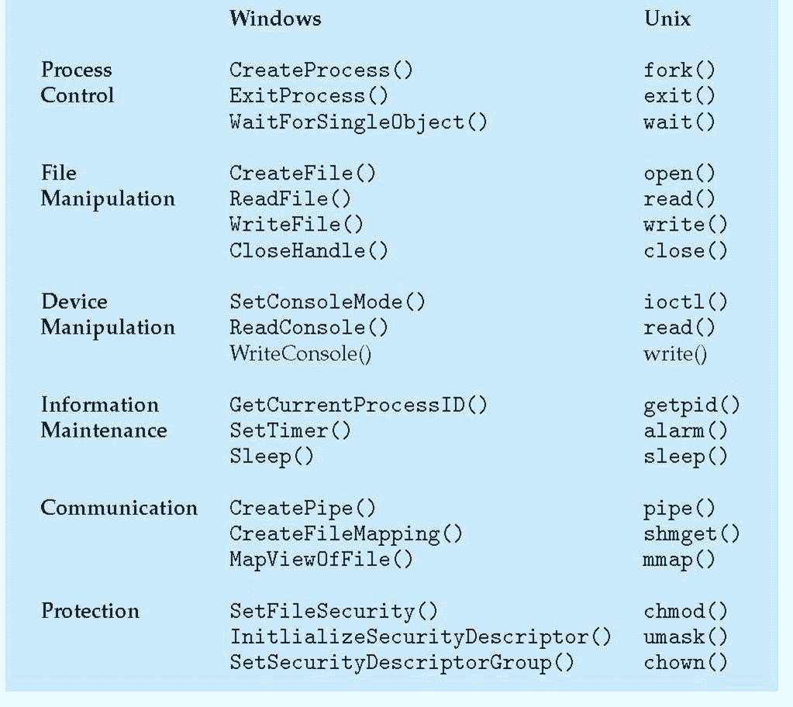
Examples of Windows and Unix System Calls

Slide 31
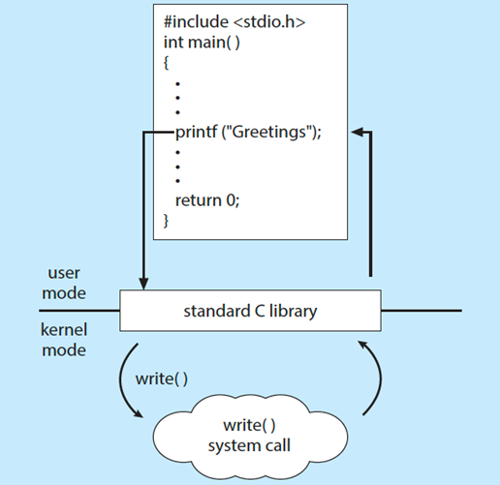
Standard C Library Example
C program invoking printf() library call, which calls write() system call

Slide 32
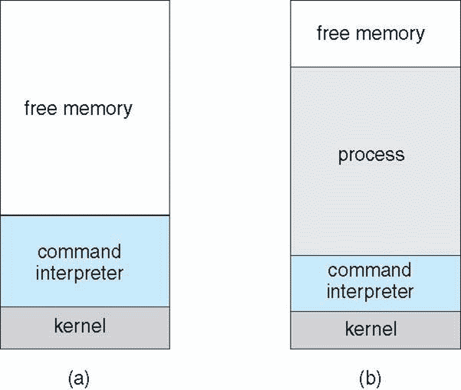
Example: MS-DOS
Single-tasking
Shell invoked when system booted
Simple method to run program
No process created
Single memory space
Loads program into memory, overwriting all but the kernel
Program exit -> shell reloaded
At system startup Running a program

Slide 33
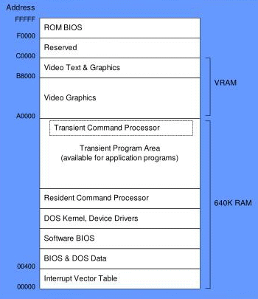
MS-DOS Memory Map

Slide 34
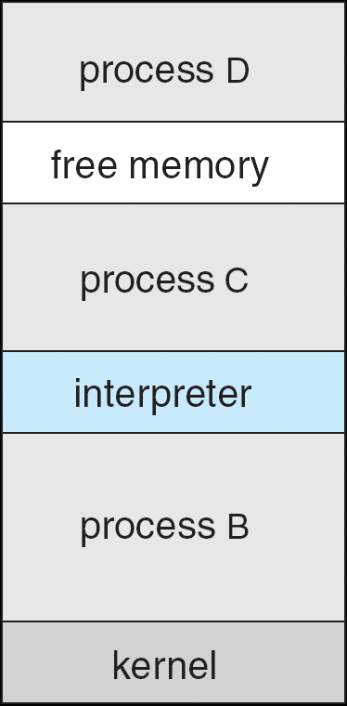
Example: FreeBSD
Unix variant
Multitasking
User login -> invoke user’s choice of shell
Shell executes fork() system call to create process
Executes exec() to load program into process
Shell waits for process to terminate or continues with user commands
Process exits with:
code = 0 – no error
code > 0 – error code
Figure 2.8

Slide 35
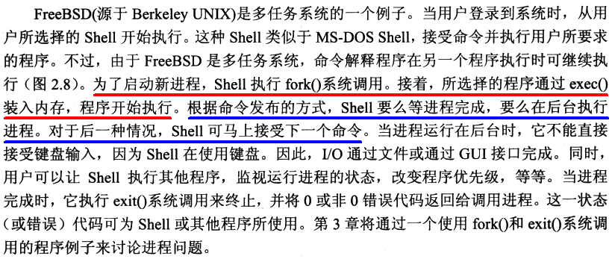
Example: FreeBSD 2

Slide 36
fork() & exec()
int main(void) { /* fork_execlp.c */
pid_t pid;
pid = fork(); /* fork a child process */
if(pid < 0) { fprintf(stderr, "Fork Failed\n"); exit(-1); }
else if (pid == 0) { /* child process */
printf("I am the child. My PID is %d, my parent's PID is %d\n", getpid(), getppid());
execlp(“ls”, “ls”, (char *)NULL);
printf("Unreachable!\n"); }
else { /* parent process */
/* parent will wait for the child to complete */
printf("I am the parent. My PID is %d, my child's PID is %d\n", getpid(), pid);
wait(NULL);
printf("Child Complete\n"); }
return 0; }

Slide 37
fork() & exec() 2
u1@ubuntu:~$ ./fork_execlp
I am the parent. My PID is 2269, my child's PID is 2270
I am the child. My PID is 2270, my parent's PID is 2269
Desktop fig3-30 fig3-34.c fork_execlp fork_pexit.c hello hello.c Music sleepn test.sh
Documents fig3-30.c fork_dsh fork_execlp.c fork_var hello2 multi-fork Pictures sleepn.c Videos
Downloads fig3-34 fork_dsh.c fork_pexit fork_var.c hello2.c multi-fork.c Public Templates
Child Complete

Slide 38
Example: FreeBSD 3
在Unix类的OS shell中，键入命令，并回车，表示执行该命令，且等待该命令执行完毕，才显示shell的提示符：
ls –R /
递归列出整个文件系统的目录后，再显示shell提示符
若在命令最后加上符号&，就表示本命令在后台执行
myprog datainputfile resultfile &
这样mywork在后台执行，shell马上显示下一个提示符，可以键入新的命令

Slide 39
2.5 System Programs
System programs provide a convenient environment for program development and execution. They can be divided into:
File manipulation
Status information
File modification
Programming language support
Program loading and execution
Communications
Background services
Application programs
Most users’ view of the operation system is defined by system programs, not the actual system calls

Slide 40
System Programs
Provide a convenient environment for program development and execution
Some of them are simply user interfaces to system calls; others are considerably more complex
File management - Create, delete, copy, rename, print, dump, list, and generally manipulate files and directories
Status information
Some ask the system for info - date, time, amount of available memory, disk space, number of users
Others provide detailed performance, logging, and debugging information
Typically, these programs format and print the output to the terminal or other output devices
Some systems implement a registry - used to store and retrieve configuration information

Slide 41
System Programs (Cont.)
File modification
Text editors to create and modify files
Special commands to search contents of files or perform transformations of the text
Programming-language support - Compilers, assemblers, debuggers and interpreters sometimes provided
Program loading and execution- Absolute loaders, relocatable loaders, linkage editors, and overlay-loaders, debugging systems for higher-level and machine language
Communications - Provide the mechanism for creating virtual connections among processes, users, and computer systems
Allow users to send messages to one another’s screens, browse web pages, send electronic-mail messages, log in remotely, transfer files from one machine to another

Slide 42
System Programs (Cont.)
Background Services
Launch at boot time
Some for system startup, then terminate
Some from system boot to shutdown
Provide facilities like disk checking, process scheduling, error logging, printing
Run in user context not kernel context
Known as services, subsystems, daemons
Application programs
Don’t pertain to system
Run by users
Not typically considered part of OS
Launched by command line, mouse click, finger poke

Slide 43
2.6 Operating System Design and Implementation
Design and Implementation of OS not “solvable”, but some approaches have proven successful
Internal structure of different Operating Systems can vary widely
Start the design by defining goals and specifications
Affected by choice of hardware, type of system
User goals and System goals
User goals – operating system should be convenient to use, easy to learn, reliable, safe, and fast
System goals – operating system should be easy to design, implement, and maintain, as well as flexible, reliable, error-free, and efficient

Slide 44
Operating System Design and Implementation (Cont.)
Important principle to separate
Policy(策略): What will be done? Mechanism(机制): How to do it?
Mechanisms determine how to do something, policies decide what will be done
The separation of policy from mechanism is a very important principle, it allows maximum flexibility if policy decisions are to be changed later (example – timer)
Specifying and designing an OS is highly creative task of software engineering

Slide 45
Implementation
Much variation
Early OSes in assembly language
Then system programming languages like Algol, PL/1
Now C, C++
Actually usually a mix of languages
Lowest levels in assembly
Main body in C
Systems programs in C, C++, and Rust, scripting languages like Perl, Python, shell scripts
More high-level language easier to port to other hardware
But slower
Emulation can allow an OS to run on non-native hardware

Slide 46
2.7 Operating System Structure
General-purpose OS is very large program
Various ways to structure ones
Simple structure – MS-DOS
More complex -- UNIX
Layered – an abstrcation
Microkernel(微内核) -Mach
Notes:
Mach是一个由卡内基梅隆大学开发的用于支持操作系统研究的操作系统内核，为了用于操作系统之研究，特别是在分布式与并行运算上。是最早实现微核心操作系统的例子之一，是许多其它相似的项目的标准

Slide 47
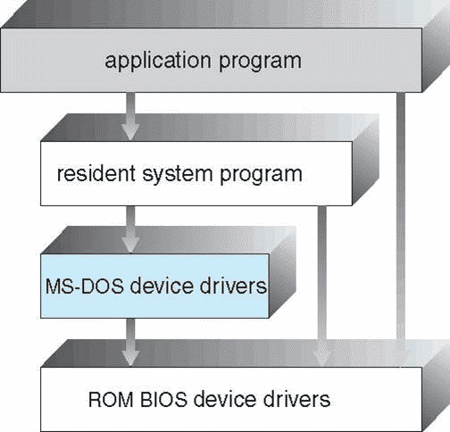
Simple Structure -- MS-DOS
MS-DOS – written to provide the most functionality in the least space
Not divided into modules
Although MS-DOS has some structure, its interfaces and levels of functionality are not well separated
Difficult to implement and maintain.

Slide 48
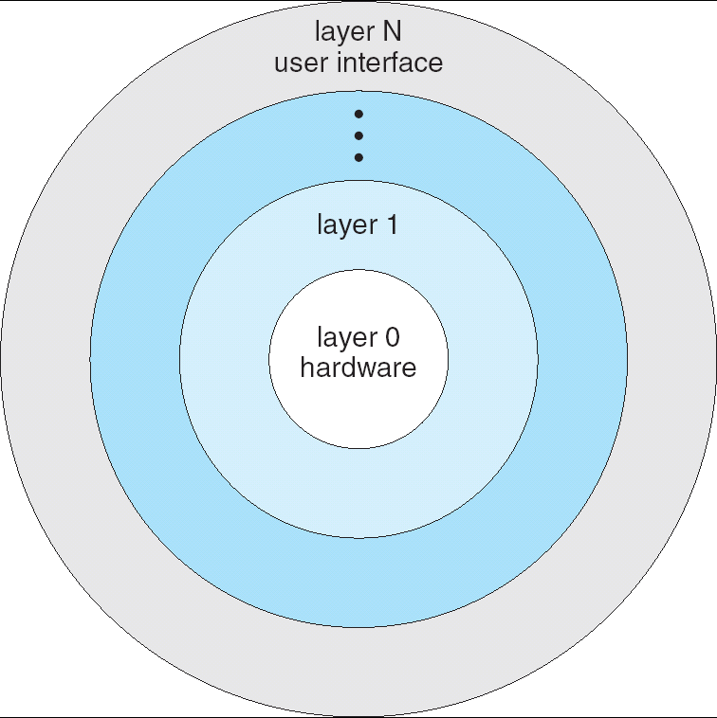
Layered Approach
The operating system is divided into a number of layers (levels), each built on top of lower layers. The bottom layer (layer 0), is the hardware; the highest (layer N) is the user interface.
With modularity, layers are selected such that each uses functions (operations) and services of only lower-level layers
Simplicity of construction and debugging
It is difficult to define the various layers
Less efficient

Slide 49
Non Simple Structure -- UNIX
UNIX – limited by hardware functionality, the original UNIX operating system had limited structuring. The UNIX OS consists of two separable parts
Systems programs
The kernel
Consists of everything below the system-call interface and above the physical hardware
Provides the file system, CPU scheduling, memory management, and other operating-system functions; a large number of functions for one level

Slide 50
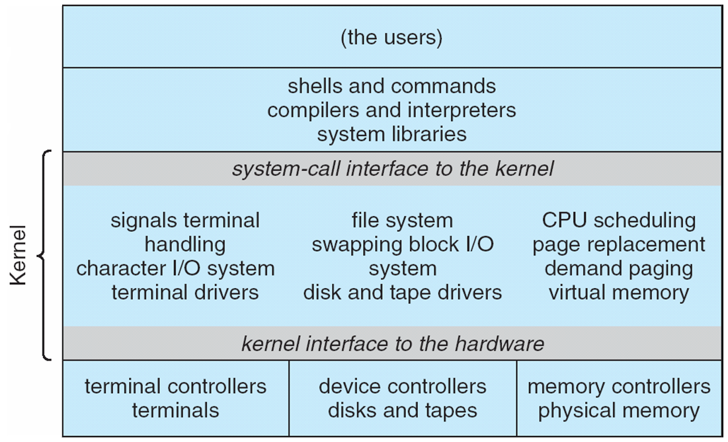
Traditional UNIX System Structure
Beyond simple but not fully layered

Slide 51
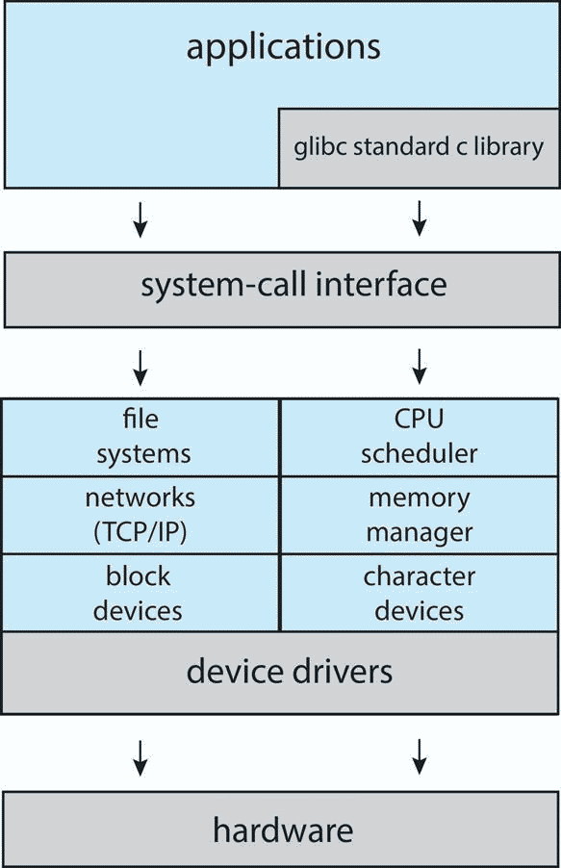
Linux System Structure
Monolithic plus modular design

Slide 52
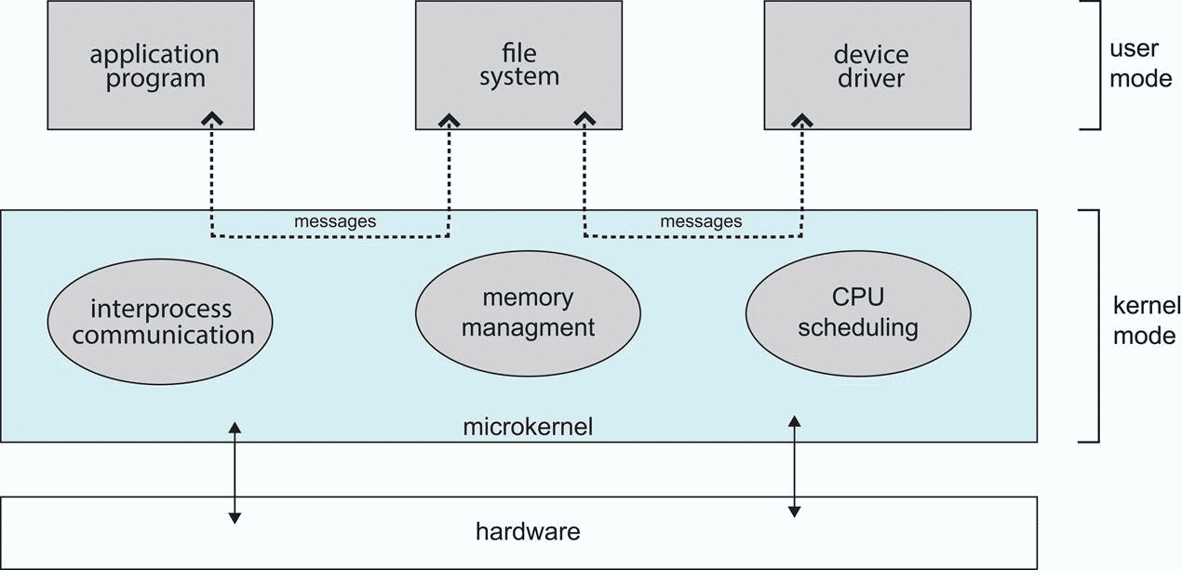
Microkernel System Structure

Slide 53
Microkernel System Structure
Moves as much nonessential parts from the kernel into “user” space, provide minimal process and memory management.
Mach example of microkernel
Mac OS X kernel (Darwin) partly based on Mach
True64 Unix QNX
Communication takes place between user modules using message passing
Benefits:
Easier to extend a microkernel
Easier to port the operating system to new architectures
More reliable (less code is running in kernel mode)
More secure
Detriments:
Performance overhead of user space to kernel space communication
Detriments:

Slide 54
Modules
Many modern operating systems implement loadable kernel modules
Uses object-oriented approach
Each core component is separate
Each talks to the others over known interfaces
Each is loadable as needed within the kernel
Allows the kernel to provide core services yet also allows certain features to be implemented dynamically.
Overall, similar to layers but with more flexible
Linux, Solaris, Mac OS X etc

Slide 55
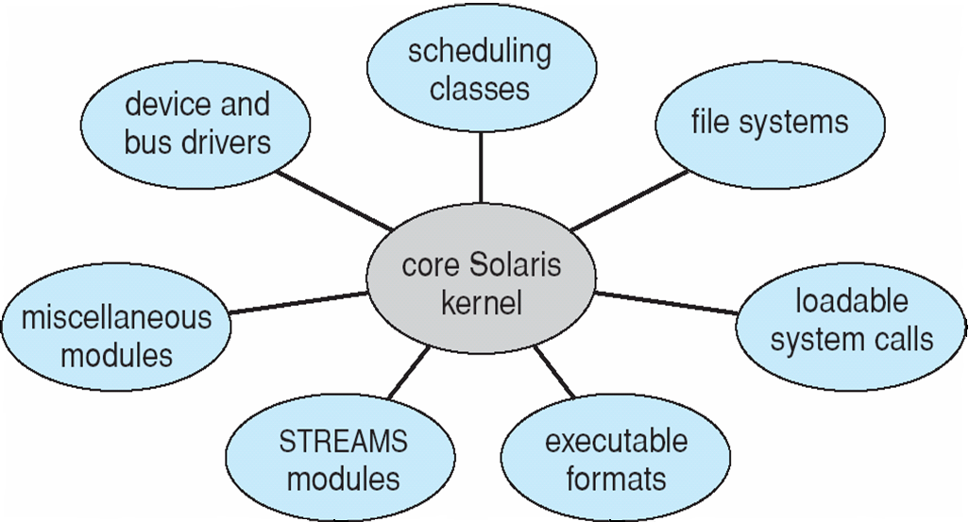
Solaris Modular Approach

Slide 56
Hybrid Systems
Most modern operating systems are actually not one pure model
Hybrid combines multiple approaches to address performance, security, usability needs
Linux and Solaris kernels in kernel address space, so monolithic, plus modular for dynamic loading of functionality
Windows mostly monolithic, plus microkernel for different subsystem personalities
Apple Mac OS X hybrid, layered, Aqua UI plus Cocoa programming environment
Below is kernel consisting of Mach microkernel and BSD Unix parts, plus I/O kit and dynamically loadable modules (called kernel extensions)

Slide 57
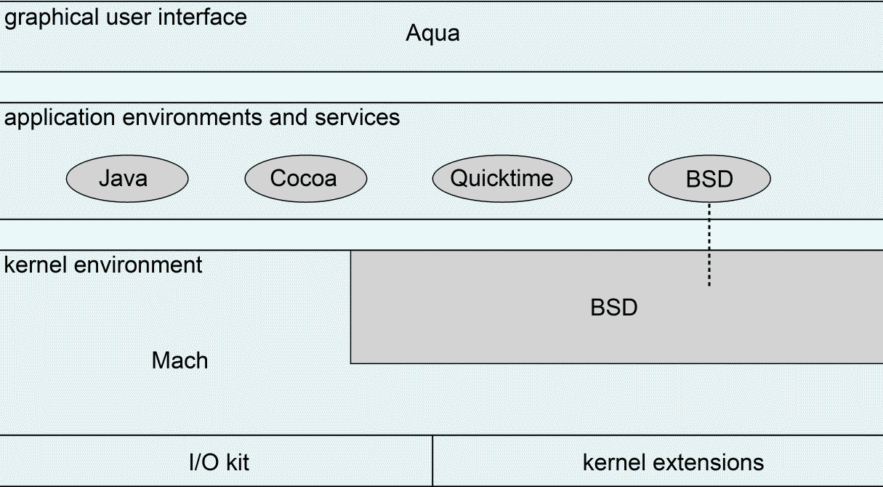
Mac OS X Structure

Slide 58
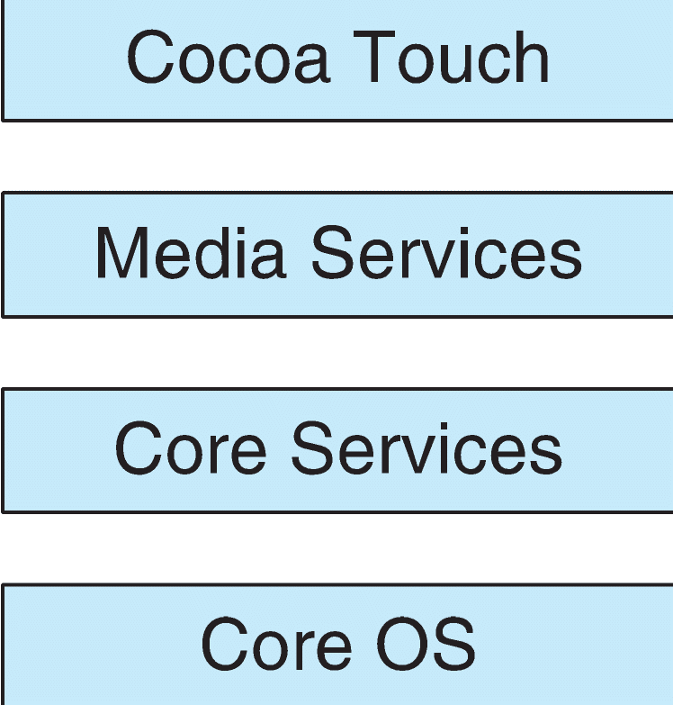
iOS
Apple mobile OS for iPhone, iPad
Structured on Mac OS X, added functionality
Does not run OS X applications natively
Also runs on different CPU architecture (ARM vs. Intel)
Cocoa Touch Objective-C API for developing apps
Media services layer for graphics, audio, video
Core services provides cloud computing, databases
Core operating system, based on Mac OS X kernel

Slide 59
Android
Developed by Open Handset Alliance (mostly Google)
Open Source
Similar stack to IOS
Based on Linux kernel but modified
Provides process, memory, device-driver management
Adds power management
Runtime environment includes core set of libraries and Dalvik virtual machine
Apps developed in Java plus Android API
Java class files compiled to Java bytecode then translated to executable than runs in Dalvik VM
Libraries include frameworks for web browser (webkit), database (SQLite), multimedia, smaller libc

Slide 60
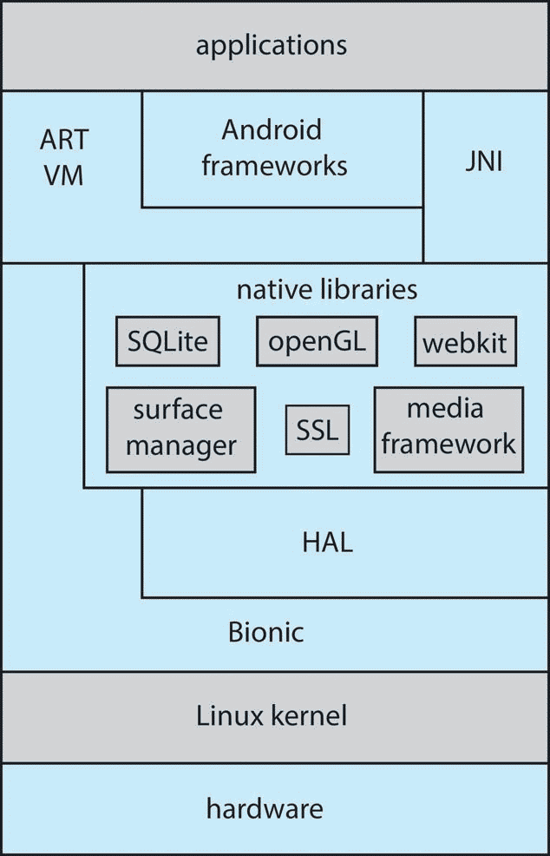
Android Architecture
Notes:
Bionic（Android的Linux内核库）

Slide 61
2.8 Virtual Machines
The fundamental idea behind a virtual machine is to abstract the hardware of a single computer into several different execution environments, thereby creating the illusion that each separate execution environment is running its own private computer.
A virtual machine takes the layered approach to its logical conclusion. It treats hardware and the operating system kernel as though they were all hardware
A virtual machine provides an interface identical to the underlying bare hardware
The operating system creates the illusion of multiple processes, each executing on its own processor with its own (virtual) memory

Slide 62
Virtual Machines (Cont.)
The resources of the physical computer are shared to create the virtual machines
CPU scheduling can create the appearance that users have their own processor
Spooling and a file system can provide virtual card readers and virtual line printers
A normal user time-sharing terminal serves as the virtual machine operator’s console

Slide 63
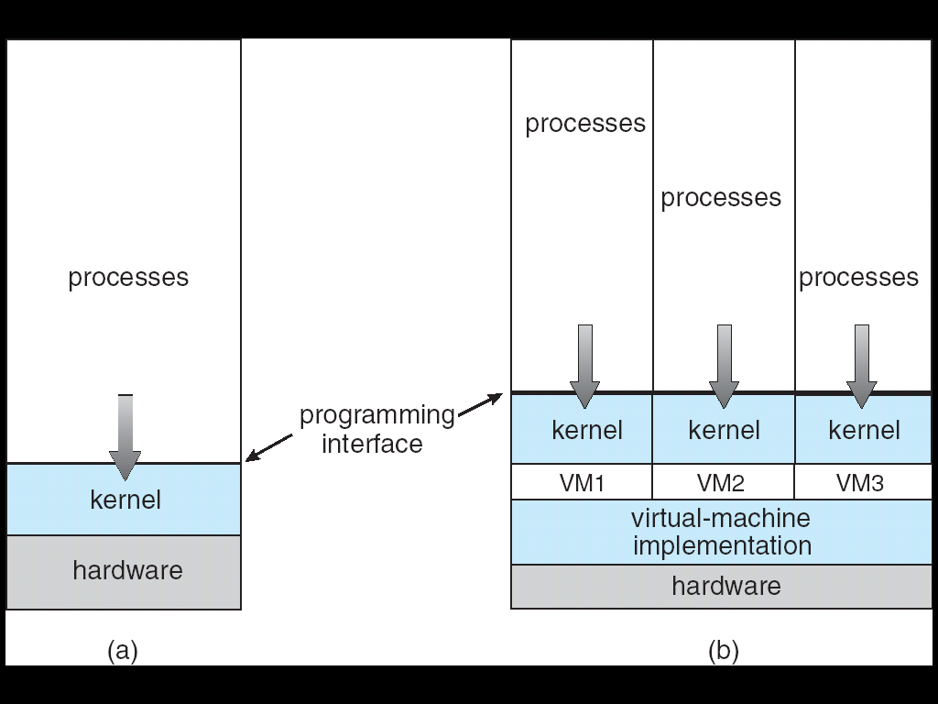
Virtual Machines (Cont.)
(a) Nonvirtual machine (b) Virtual machine
Non-virtual Machine
Virtual Machine

Slide 64
Virtual Machines (Cont.)
The virtual-machine concept provides complete protection of system resources since each virtual machine is isolated from all other virtual machines. This isolation, however, permits no direct sharing of resources.
A virtual-machine system is a perfect vehicle for operating-systems research and development. System development is done on the virtual machine, instead of on a physical machine and so does not disrupt normal system operation.
The virtual machine concept is difficult to implement due to the effort required to provide an exact duplicate to the underlying machine

Slide 65
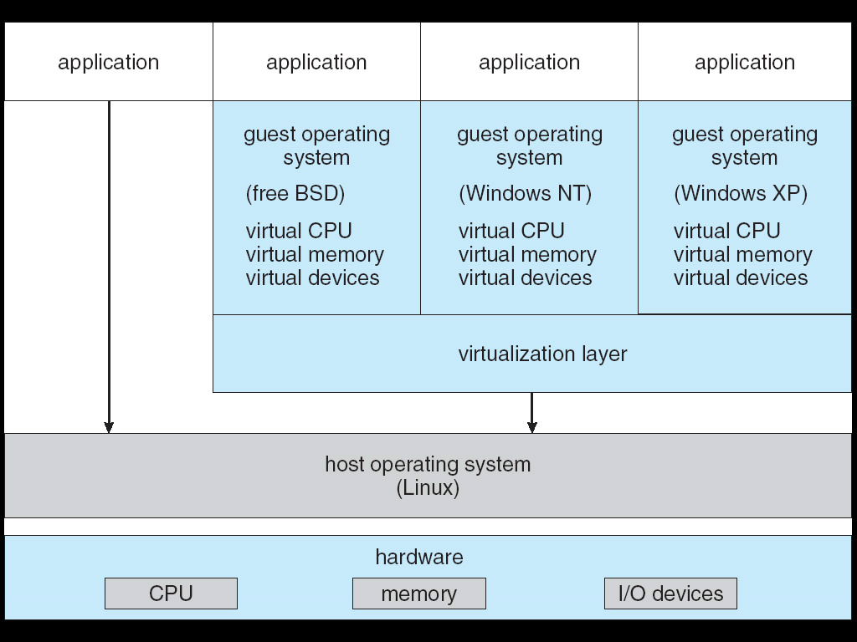
VMware Architecture

Slide 66
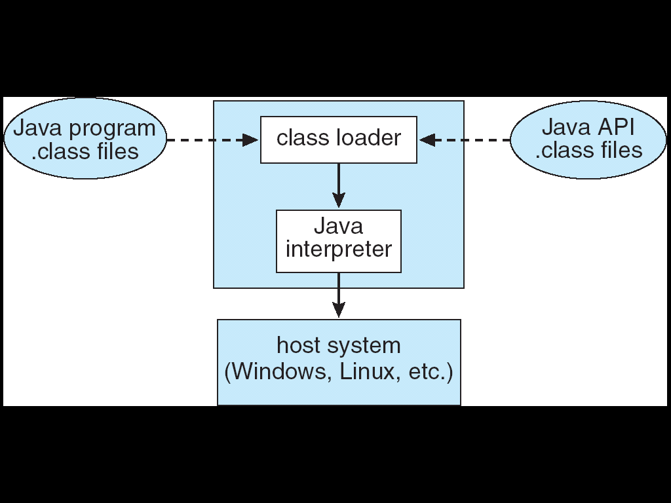
The Java Virtual Machine

Slide 67
2.9 Operating System Generation
Operating systems are designed to run on any of a class of machines; the system must be configured for each specific computer site
SYSGEN program obtains information concerning the specific configuration of the hardware system
Booting – starting a computer by loading the kernel
Bootstrap program – code stored in ROM that is able to locate the kernel, load it into memory, and start its execution

Slide 68
2.10 System Boot
Operating system must be made available to hardware so hardware can start it
Small piece of code – bootstrap loader, locates the kernel, loads it into memory, and starts it
Sometimes two-step process where boot block at fixed location loads bootstrap loader
When power initialized on system, execution starts at a fixed memory location
Firmware used to hold initial boot code
Notes:
统一可扩展固件接口（Unified Extensible Firmware Interface，缩写UEFI）是一种个人电脑系统规格，用来定义操作系统与系统固件之间的软件界面，作为BIOS的替代方案

Slide 69
*Operating-System Debugging
Debugging is finding and fixing errors, or bugs
OS generate log files containing error information
Failure of an application can generate core dump(核心转储) file capturing memory of the process
Operating system failure can generate crash dump(崩溃转储) file containing kernel memory
Beyond crashes, performance tuning can optimize system performance
Sometimes using trace listings of activities, recorded for analysis
Profiling is periodic sampling of instruction pointer to look for statistical trends
Kernighan’s Law: “Debugging is twice as hard as writing the code in the first place. Therefore, if you write the code as cleverly as possible, you are, by definition, not smart enough to debug it.”

Slide 70
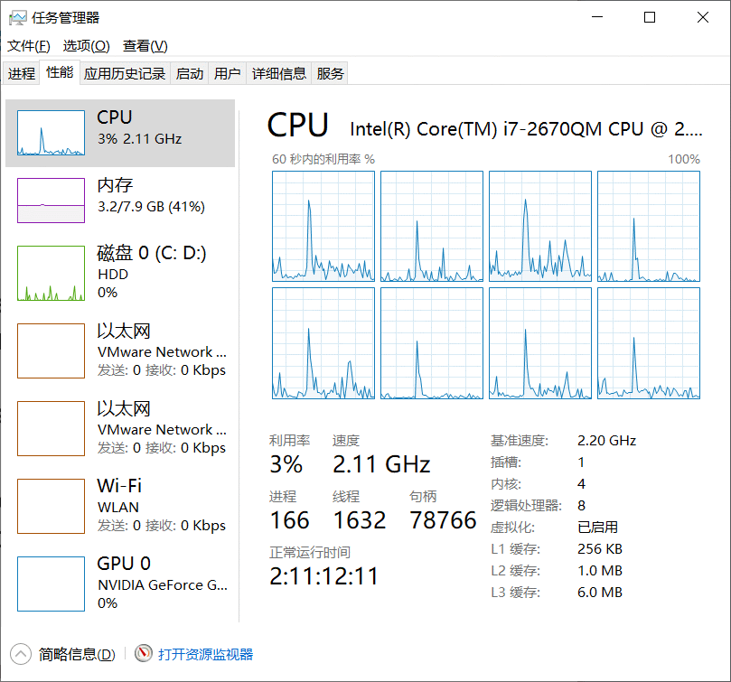
*Performance Tuning
Improve performance by removing bottlenecks
OS must provide means of computing and displaying measures of system behavior
For example, “top” program or Windows Task Manager

Slide 71
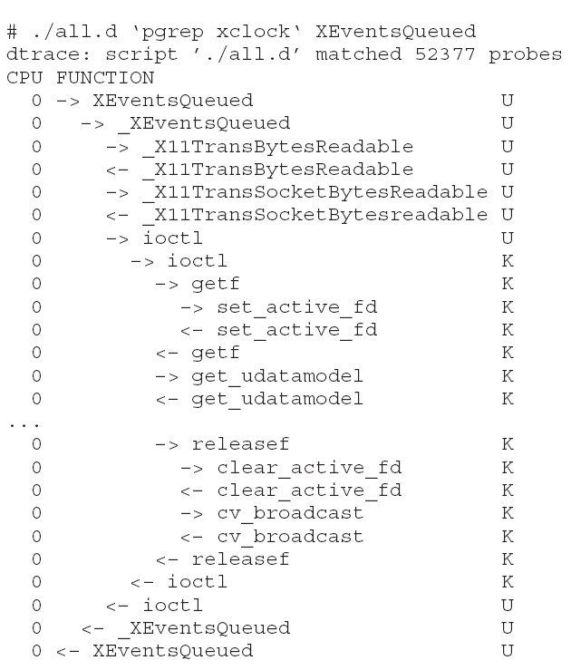
*DTrace
Dtrace(动态跟踪) tool in Solaris, FreeBSD, Mac OS X allows live instrumentation on production systems
Probes fire when code is executed within a provider, capturing state data and sending it to consumers of those probes
Example of following XEventsQueued system call move from libc library to kernel and back

Slide 72
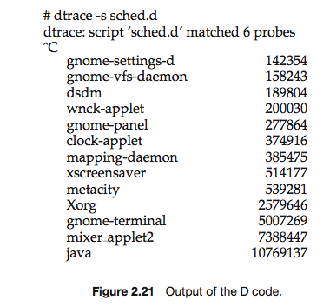
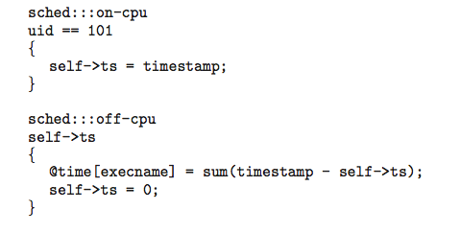
*Dtrace (Cont.)
DTrace code to record amount of time each process with UserID 101 is in running mode (on CPU) in nanoseconds

Slide 73
Summary 1/6
An operating system provides an environment for the execution of programs by providing services to users and programs.
The three primary approaches for interacting with an operating system are (1) command interpreters, (2) graphical user interfaces, and (3) touchscreen interfaces.
System calls provide an interface to the services made available by an operating system. Programmers use a system call’s application programming interface (API) for accessing system-call services.

Slide 74
Summary 2/6
System calls can be divided into six major categories: (1) process control, (2) file management, (3) device management, (4) information maintenance, (5) communications, and (6) protection.
The standard C library provides the system-call interface for UNIX and Linux systems.
Operating systems also include a collection of system programs that provide utilities to users.

Slide 75
Summary 3/6
A linker combines several relocatable object modules into a single binary executable file. A loader loads the executable file into memory, where it becomes eligible to run on an available CPU.
There are several reasons why applications are operating-system specific. These include different binary formats for program executables, different instruction sets for different CPUs, and system calls that vary from one operating system to another.
An operating system is designed with specific goals in mind. These goals ultimately determine the operating system’s policies. An operating system implements these policies through specific mechanisms.
Notes:
eligible adj.有资格的；合格的；具备条件的

Slide 76
Summary 4/6
A monolithic(单体/宏内核) operating system has no structure; all functionality is provided in a single, static binary file that runs in a single address space. Although such systems are difficult to modify, their primary benefit is efficiency.
A layered operating system is divided into a number of discrete layers, where the bottom layer is the hardware interface and the highest layer is the user interface. Although layered software systems have had some success, this approach is generally not ideal for designing operating systems due to performance problems.

Slide 77
Summary 5/6
The microkernel approach for designing operating systems uses a minimal kernel; most services run as user-level applications. Communication takes place via message passing.
A modular approach for designing operating systems provides operating system services through modules that can be loaded and removed during run time. Many contemporary operating systems are constructed as hybrid systems using a combination of a monolithic kernel and modules.

Slide 78
Summary 6/6
A boot loader loads an operating system into memory, performs initialization, and begins system execution.
The performance of an operating system can be monitored using either counters or tracing. Counters are a collection of system-wide or preprocess statistics, while tracing follows the execution of a program through the operating system

Slide 79
End of Chapter 2: Operating-System Structures

